Slide 1


IMDb Web Scraping and Data Analysis of Top 500 Movies

Slide 2
About me
Shaik. Sohel – BSc in Computer Science.
Passionate about studying how to improve performance.
Aspiring to become a Data Scientist.

Slide 3
Agenda
Objective of the Project
I present to you my first Web Scraping and Exploratory Data Analysis (EDA) project, which accompanied me on my Data Science journey that I started at INNOMATICS RESEARCH LABS. This report is an interesting survey about the IMDB movie ratings and observation what are the reasons that audiences like more a movie than the others.
Web Scraping – Details (Websites, Processor you followed)
https://www.imdb.com/list/ls050782187/?sort=user_rating,desc&st_dt=&mode=detail
Summary of the Data
The data about top 500 IMDb movies of all time- Ranking,the duration of movie, Gross, Genre, IMDb rating, Metascore, Release date and Votes.

Slide 4
Agenda
Exploratory Data Analysis:
Data Cleaning Steps
Info command to check the data types of variables
Checked for null values
Fixed structural errors
Deal with missing data
Data Manipulation Steps
Replace – to replace or remove a string
astype to change the datatype
Split to split a column in to two columns

Slide 5
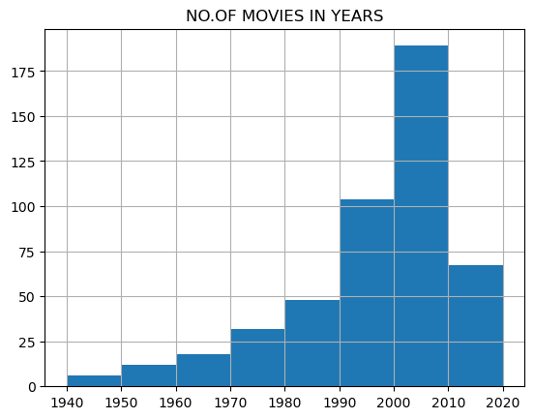
Agenda
A histogram is a graph showing the frequency distribution and is often used for numeric data
A histogram is a graph showing the frequency distribution and is often used for numeric data
Univariate Analysis Steps
Histogram graph between Number of movies and Year for certain rows

Slide 6
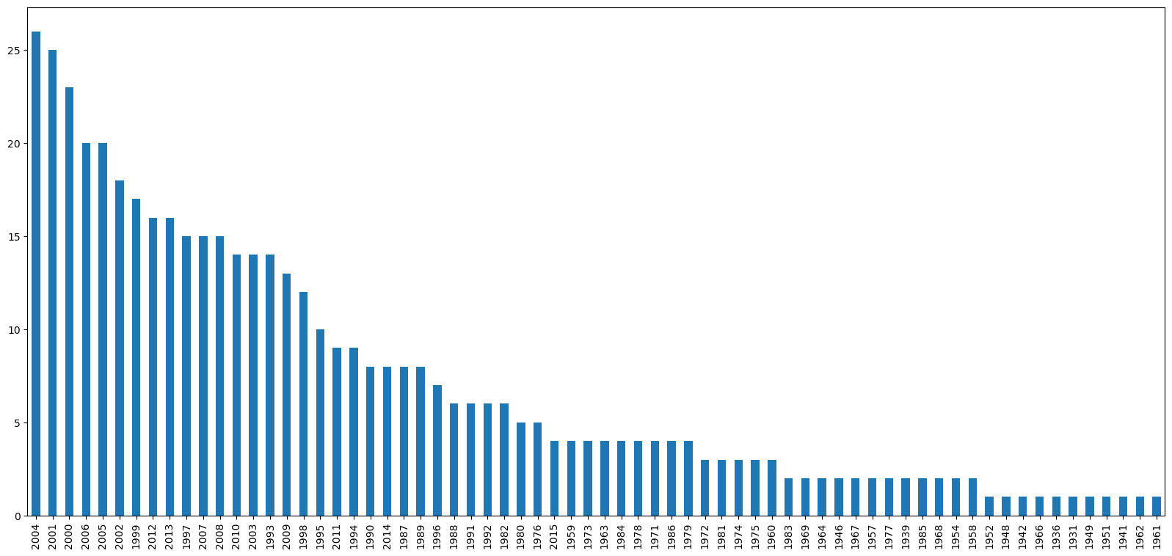
Agenda
1(b). Count plot number of movies per year

Slide 7
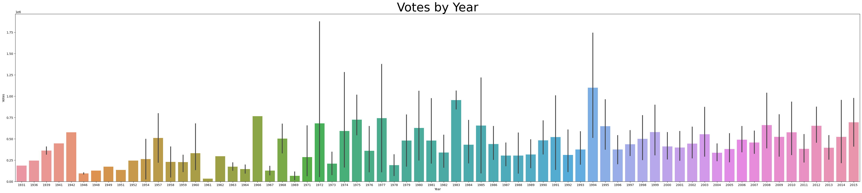

Agenda
2. Bar plot to see which year has more votes counts.

Slide 8
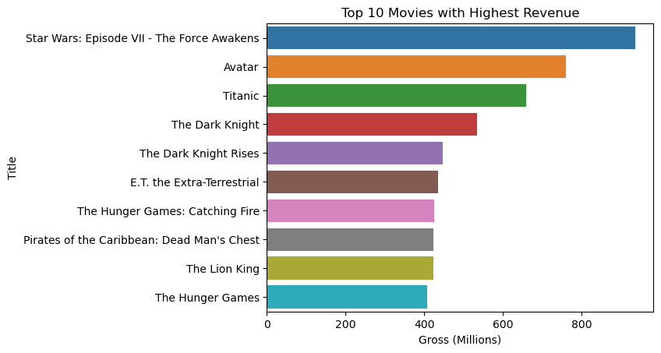
Agenda
3.Bar plot of 10 top highest revenue generated movies.

Slide 9
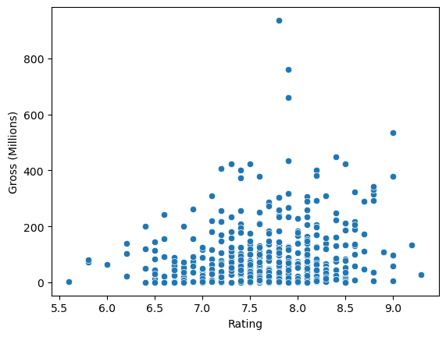
Agenda
4. Scatter plot to see does rating effect the revenue?

Slide 10
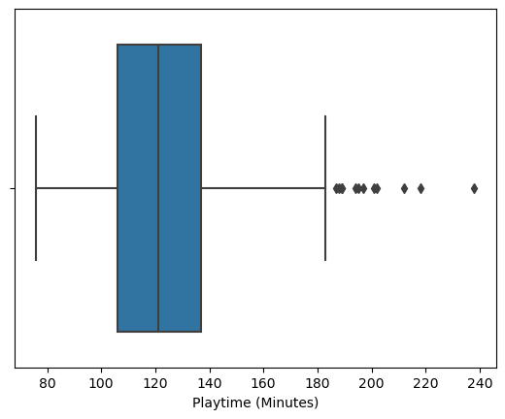
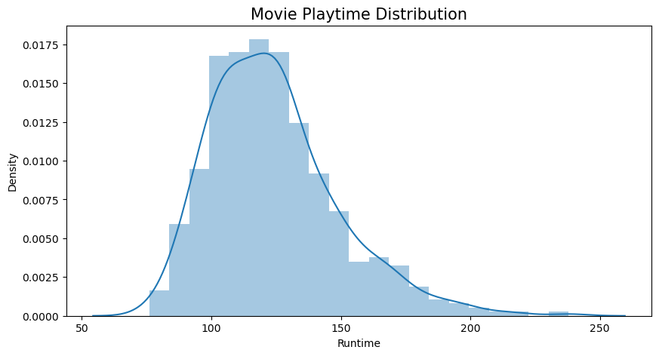
Agenda
5. Box plot
6.Dist plot

Slide 11
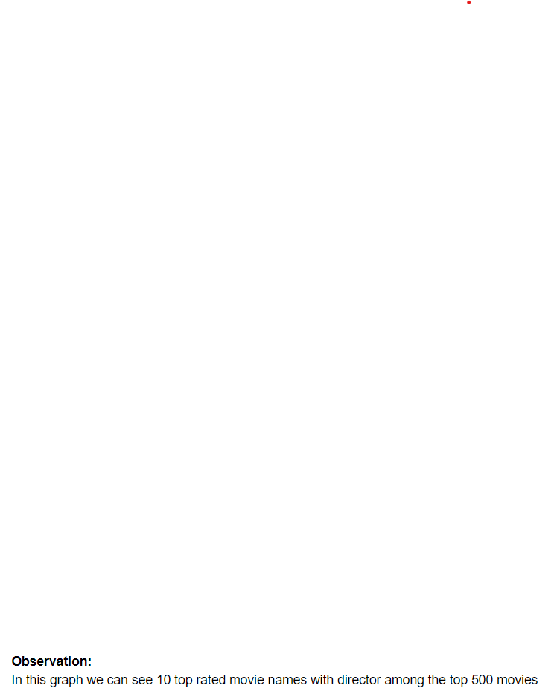
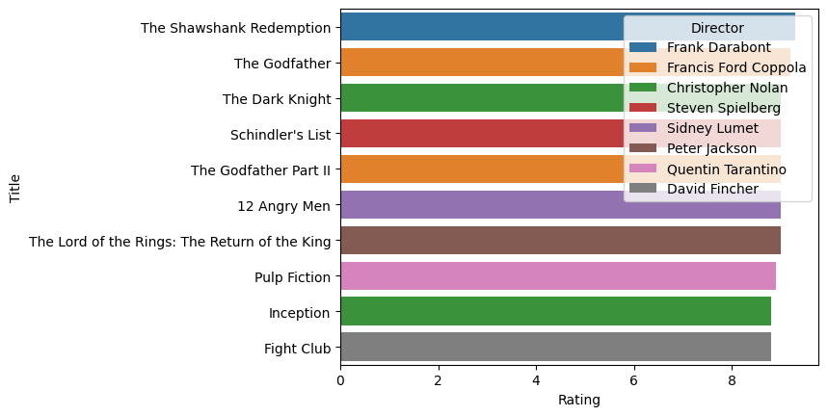
Agenda
7.Barplot of top rated movies with director names.

Slide 12
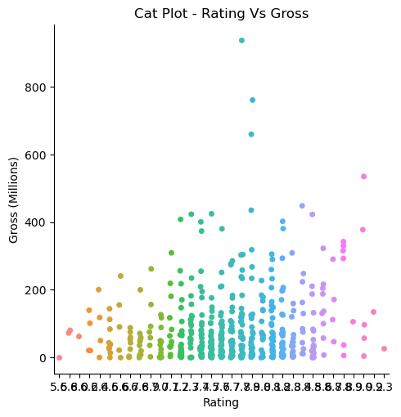
Agenda
9.Cat plot Gross v Rating

Slide 13
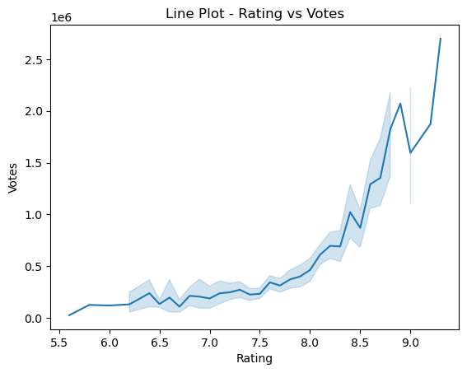
Agenda
10. Line plot:

Slide 14
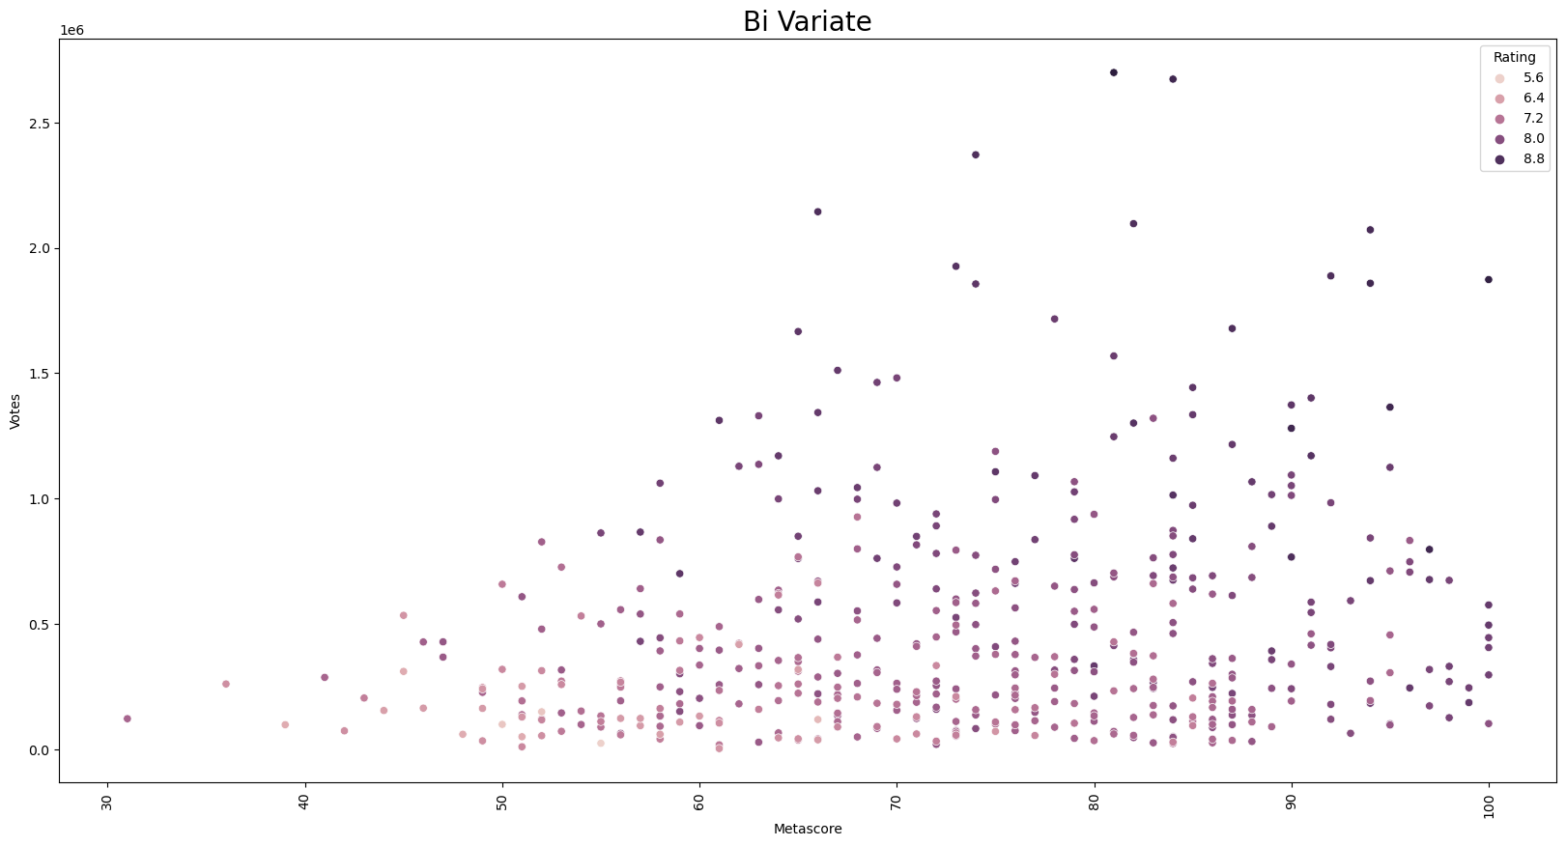
Agenda
Bivariate Analysis
1. Scatter plot between No. of votes, Rating and Metascore

Slide 15
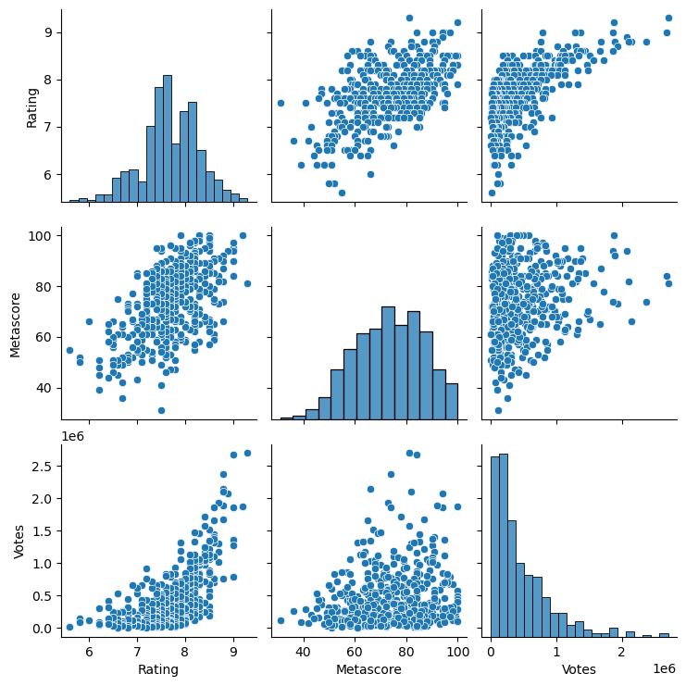
Agenda
2. Pair plot between No. of Votes, Rating and Metascore.

Slide 16
Agenda
Key Business Question:
How is the average playtime of movie?
Revenue of the movie depends on rating?
Which year has the highest revenue?
Which movie have the highest revenue?
Conclusion (Key finding overall)
The top 3 genres with the highest IMDB Scores are Drama, Crime Drama, and Action.
Most of Movies Belongs to Runtime Range - 100 to 140 Minutes
We have observed that revenue and rating have positive correlation
Movies with highest rating has highest votes
The highest number of votes were seen in year 1994 and 1983 compared to remaing years
we can observe that year 2015 has the highest revenue,double of its past years
we can observe that only these 10 movies have crosses the 400 million revenue remaining all are under 400 Million
Star Wars: Episode VII - The Force Awakens is the highest gross movie

Slide 17
Agenda
Q & A

Slide 18
EXPERINCES & CHALLENGES
The project on Web Scraping and Data Analysis helped to learn to convert large amount of unstructured data in to structured data by cleaning, manipulating and analyzing the data.
The main challenge faced in the project while manipulating the data and in eda process.
Libraries Used:
pandas
numpy
BeautifulSoup
matplotlib.pyplot
re
seaborn

Slide 19

THANK YOU

